Slide 1
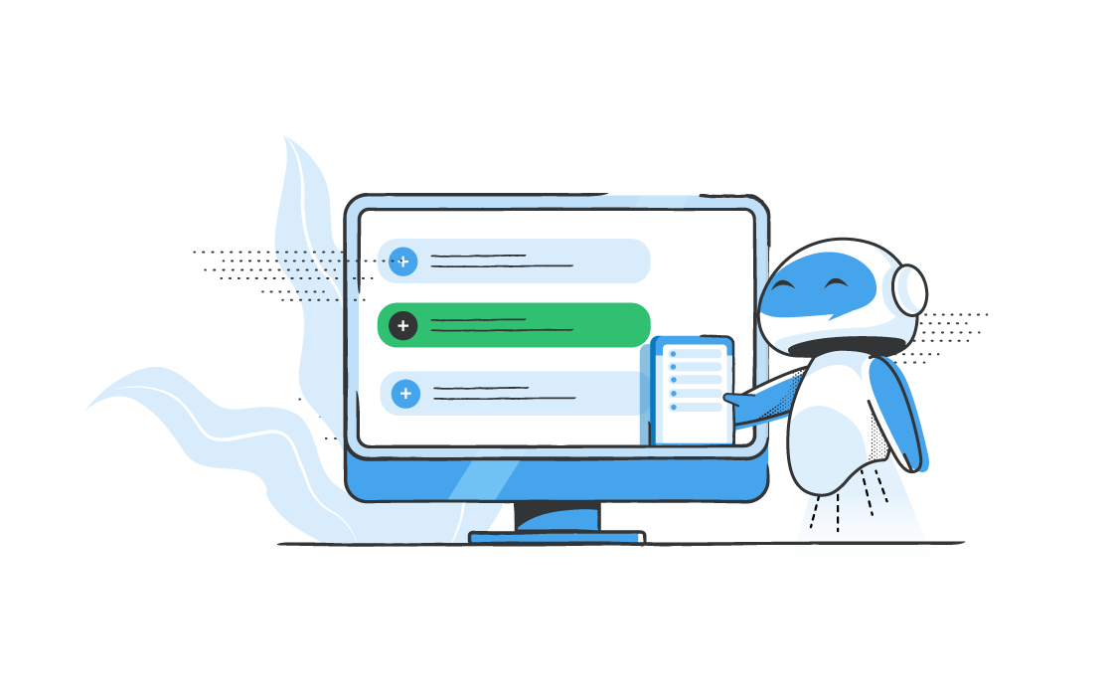

Chatbot For Revenue Website
Attri Mohit B.

Slide 2
Chatbot For Revenue Website
Attri Mohit B.

Slide 3

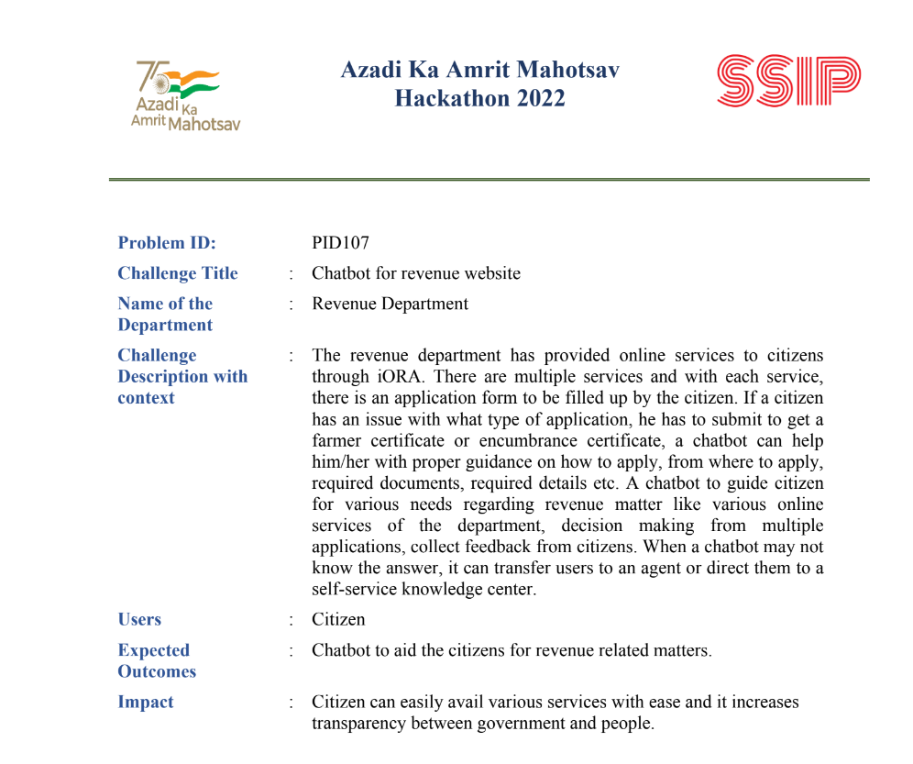
Iora- Integrated Online Revenue Applications

Slide 4
The revenue department has provided online services to citizensthrough iORA. There are multiple services and with each service,there is an application form to be filled up by the citizen. If a citizenhas an issue with what type of application, he has to submit to get afarmer certificate or encumbrance certificate, a chatbot can helphim/her with proper guidance on how to apply, from where to apply,required documents, required details etc. A chatbot to guide citizenfor various needs regarding revenue matter like various onlineservices of the department, decision making from multipleapplications, collect feedback from citizens. When a chatbot may notknow the answer, it can transfer users to an agent or direct them to aself-service knowledge center
Users : Citizen
Expected Outcomes: Chatbot to aid the citizens for revenue related matters.
Impact : Citizen can easily avail various services with ease and it increasestransparency between government and people.

Slide 5
Challenges/Vision
A developer can contribute to the design, development, and maintenance of a website. This can include tasks such as coding the front-end and back-end of the website, implementing features and functionality, debugging and troubleshooting issues, and optimizing the website for performance and accessibility. Additionally, a developer may also be responsible for integrating the website with external systems, such as databases and APIs, and ensuring the website is secure and compliant with industry standards.

